Slide 1
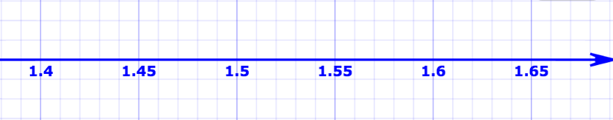
You measure the index of refraction of a piece of glass by two independent methods. The two results are:
  n = 1.55 +/- 0.10 (method 1)
  n = 1.45 +/- 0.03 (method 2)
(Method 2 is more accurate and precise, so it has a smaller uncertainty.)
Question: the correct combined result is:
1.50 +/- 0.10
1.50 +/- 0.02
1.45 +/- 0.05
1.458 +/- 0.029
Method 2
Method 1
Combined result: weighted average
To average results with different uncertainties, use the formulae for weighted averages. These tell us both the best average value and the uncertainty on the average value.

Slide 2
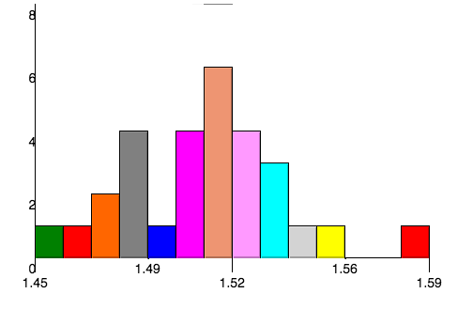
A gizmo allows us to measure the index of refraction of a block of glass. The gizmo reports the results with two decimal places (1.54 or 1.55, for example). Measuring the same block of glass 29 times, we make the following histogram of our results.
The uncertainty on a single measurement is:
  0.01
  about 0.07
  roughly 0.03 or 0.04
29 measurements of the index of refraction
For random errors (“statistical”), about 30% should be outside one error bar.
The standard deviation tells us the uncertainty on one measurement.

Slide 3
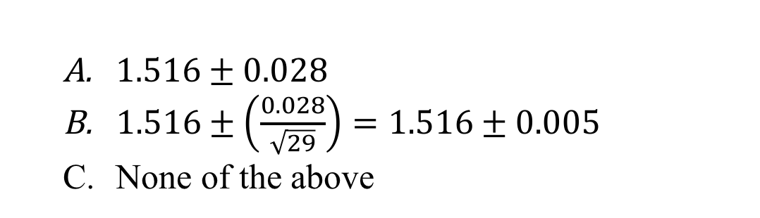
The average value of the 29 measurements is 1.516. The standard deviation is 0.028. The value that we should report for the index of refraction is:
  $1.516±0.028$
  $1.516±\left(\frac{0.028}{\sqrt{29}}\right)=1.516±0.005$
  None of the above
29 measurements of the index of refraction
Mean result with standard deviation of the mean as the uncertainty.
The standard deviation is the correct uncertainty on a single measurement.
The standard deviation of the mean is the correct uncertainty on the average value of all the measurements.

Slide 4
Why should we repeat measurements?
  Actually, there is no good reason to repeat measurements. The last digit on the device display scale tells us the uncertainty on the measurement.
  Repetition allows us to determine the correct statistical uncertainty on a single measurement (via the standard deviation), and dramatically reduces the uncertainty by allowing us to average the results. The uncertainty on the mean (‘the standard deviation of the mean’) is much smaller than that of a single measurement.

Slide 5
The procedure to determine a systematic uncertainty is:
  Calculate the standard deviation of your repeated meaurements.
  Calculate the standard deviation of the mean of your repeated measurements.
  There is no simple formula for determining the systematic uncertainty.
Systematic uncertainties bias your measurements in the same direction – they do not vary from one measurement to the next. A simple example is a ruler that has the wrong scale printed on it.
To determine the systematic uncertainty, we have to think very carefully about what effects may be biasing our results.

